Slide 1
Placement in VLSI Physical Design-2

Slide 2
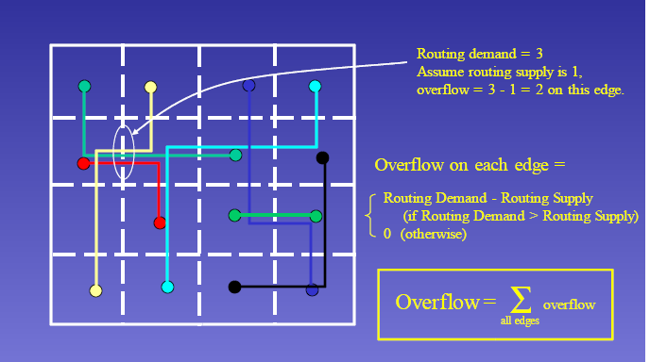
What is Congestion?

Slide 3
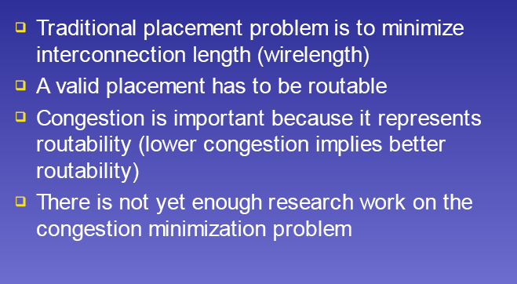
Congestion Minimization

Slide 4
Placement: Partitioning Approach
Find a good cut direction and position.
Improve the cut value

Slide 5
Partitioning based placement: Breuer’s algorithm
The goal
– to reduce the number of nets being cut when the circuit is partitioned
Three objectives:
1. To minimize the number of nets cut by partitioning
2. To reduce the number of nets cut by the cut line across the channel (in case of standard cell and gate arrays)
3. To reduce the number of nets cut in a sequential manner (after each partition, number of nets cut is minimized)

Slide 6
Breuer’s algorithm: Different Procedures
Cut oriented Min-cut Placement
1. The chip is first cut by a partition into two blocks
2. The circuit is also partitioned into two subcircuits so that the net cut is minimized
3. All the blocks formed by the partition are further partitioned by the second cut line and this process carried out
2
Problems:
1. While processing a cut line, the blocks created by previous cut lines have to be partitioned simultaneously
2. When a cut line partitions a block into two, the blocks to be placed in one of the partition might not fit in the partition created by cut line
4
1
3

Slide 7
Breuer’s algorithm: Different Procedures
Quadrature Placement
1. Each region is partitioned into four regions of equal sizes by using horizontal and vertical lines alternatively
2. During each partitioning, the cutsize of the partition is minimized
2a
2a
2b
1b
2b
1a

Slide 8
Breuer’s algorithm: Different Procedures
Bisection Placement
1. The layout area is repeatedly bisected into two equal parts by horizontal cut lines until each subregion consists of one row
2. Each of these rows are repeatedly bisected by vertical cut lines till each resulting subregion contains only one slot thus fixing the position of all blocks
3
2a
The method is usually used for standard cell placement
1
2b
4a
4b
Does not guarantee the minimization of the maximum net cut per channel

Slide 9
Breuer’s algorithm: Different Procedures
Slice Bisection Placement
1. A suitable number of blocks are partitioned from the rest of the circuit and assigned to a row (called as slicing), by horizontal cut line
2. Step-1 is repeated until each block is assigned to a row
3. The blocks in each row are then assigned to columns by bisecting using vertical cut lines
6a
5
6b
1
The method is most suitable for circuits having a high degree of interconnection at periphery
2
3
4

Slide 10
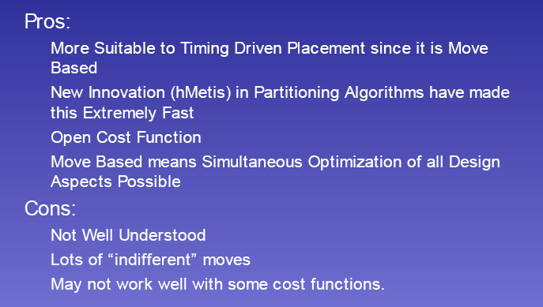
Partitioning: Pros and Cons

Slide 11
Simulated Annealing (SA) Placement
Stage 1
Modules are moved between different rows as well as within the same row
module overlaps are allowed (to reduce running time)
when temperature is reduced below a certain value, stage 2 begins
Stage 2
Remove overlaps
Annealing process continues, but only interchanges adjacent modules within the same row

Slide 12
Issues in SA Based Placement
Cost
  Area (usually fixed # of rows, variable row width)
  Wirelength
  Cell overlap (penalty increases with temperature)
Moves
  Exchange two cells within a radius R
  Displace a cell within a row
  Flip a cell horizontally
  Range limiter limits distance over which a cell can move
Low vs. High temperature
  If used as a post processing, start with low-temp
Post-processing?
  Might be needed if there are still overlaps

Slide 13
SA Based Placement: Overview
Start with an initial placement
- Accept all moves which result in a reduction in a cost
- Moves resulting a cost increase may be accepted
( with the probability of decrease in cost in future)
- A parameter T (Temperature) controls acceptance probability

Slide 14
SA Based Placement: Overview
Algorithm SA
begin
temp := INIT_TEMP
place := INIT_PLACEMENT;
while (inner_loop_criterion - false) do
new_place := PERTURB(place);
ΔC := COST(new_place) - COST(place);
if (ΔC < 0) then place := new_place;
else if (RANDOM(0,1) > e^{ΔC/temp)} then
place := new_place;
temp := SCHEDULE(temp);
end.

Slide 15
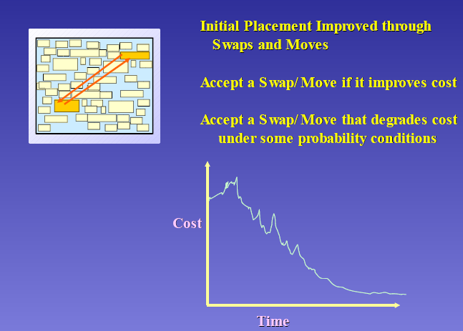
SA Based Placement

Slide 16
Solution Space
All possible arrangements of modules into rows possibly with overlaps
overlaps

Slide 17
Neighboring Solutions
Three types of moves:
.
M1: Displace a module to a new location
.
M2: Interchange two
modules
M3: Change the orientation of a module
1 2
2 1
1 2
Axis of reflections
3 4
3 4
3 4

Slide 18
Move Selection
Timber wolf first tries to select a move between M1 and M2
    Prob(M1) > Prob(M2)
If a move of type M1 is chosen ( for certain module) and it is rejected, then a move of type M3 (for the same module) will be chosen with probability 1/10
Restriction on:
How far a module can be displaced
What pairs of modules can be interchanged
M1: Displacement
M2: Interchange
M3: Reflection

Slide 19
Move Restriction
Range Limiter
At the beginning, R is very large, big enough to contain the whole chip
Window size shrinks slowly as the temperature decreases. In fact, height and width of R ∝ log(T)
Stage 2 begins when window size is so small that no inter-row modules interchanges are possible
Rectangular window R

Slide 20
Cost Function
net i
Ψ = C₁+C₂+C₃
h_{i}
C
:
∑
(
α
w
+
β
h
)
Wirelength cost
w_{i}
1
i
i
i
i
i
α_{i}, β_{i} are horizontal and vertical weights, respectively
α_{i} =1, β_{i} =1 ⇒1/2 •perimeter of bounding box
Critical nets: Increase both α_{i} and β_{i}
Preferred metal layer routing: if vertical wirings are “cheaper” than horizontal wirings, we can use smaller vertical weights, i.e. β_{i}< α_{i}

Slide 21
Cost Function (Contd.)
C₂: Penalty function for module overlaps
  O(i,j) = amount of overlaps in the X-dimension
  between modules i and j
  α — offset parameter to ensure C₂ → 0 when T → 0
C
=
∑
(
O
(
i
,
j
)
+
α
)
2
2
i
≠
j
C₃: Penalty function that controls the row lengths
  Desired row length = d(r)
  l(r) = sum of the widths of the modules in row r
C
=
∑
β
l
(
r
)
−
d
(
r
)
3
r

Slide 22
Annealing Schedule
T_{k} = r(k)•T _{k-1} k= 1, 2, 3, ….
  r(k) increases from 0.8 to max value 0.94 and then decrease to 0.1
  At each temperature, a total number of K•n attempts is
  made
  n= number of modules
  K= user specified constant
Annealing starts at a high temperature (say 4,000,000)
The algorithm terminates when T is very small (say, 0.1)

Slide 23
Range Limit in Movement
A temperature dependent range limiter is used to limit the distance over which a cell can move
Initially the span of of the range limiter is twice the span of the chip
The span decreases logarithmically with the temperature
L_{WV}(T) = L_{WV}(T₁) * log(T) /log(T₁)
L_{WH}(T) = L_{WH}(T₁) * log(T) /log(T₁)
where, T = current Temperature
T₁= initial temperature
L_{WV}(T) = vertical window span at temperature T
L_{WH}(T) = horizontal window span at temperature T

Slide 24
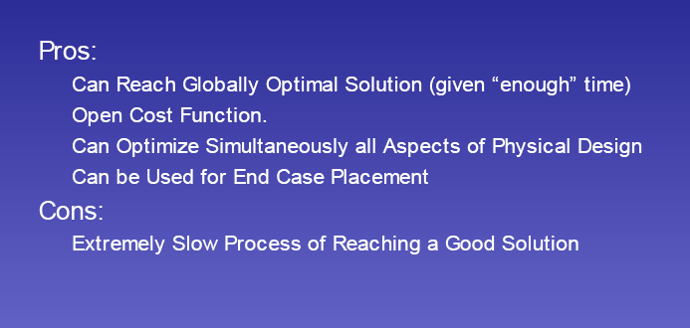
Pros and Cons of SA

Slide 25
Analytical Placement
Write down the placement problem as an analytical mathematical problem
Solve the placement problem directly
Example:
  Sum of squared wire length is quadratic in the cell coordinates.
  So the wirelength minimization problem can be formulated as a quadratic program.
  It can be proved that the quadratic program is polynomial time solvable

Slide 26
Why formulate the problem this way?
Because it is trivial to solve
Because there is only one solution
Because the solution is a global optimum
Because the solution conveys “relative order” information
Because the solution conveys “global position” information

Slide 27
Why Analytical ?
Inherently minimize the wirelength
Efficient Intrinsically
  Elegant convex quadratic programming formulation
  Very efficient techniques to solve convex Quadratic Problem
Typically employ a flat placement methodology
All cells are placed simultaneously
Maintain relative positions of cells throughout the placement process

Slide 28
Gordian: A Quadratic Placement Approach
Global optimization: solves a sequence of quadratic programming problems
Partitioning: enforces the non-overlap constraints

Slide 29
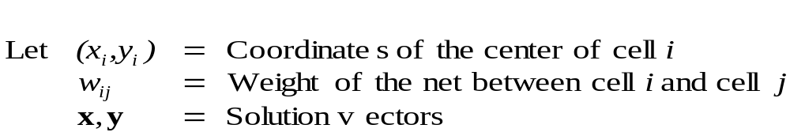
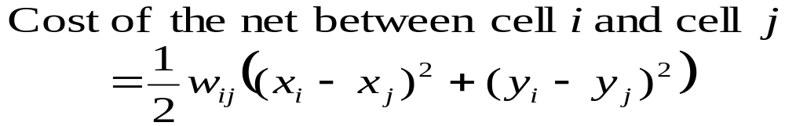
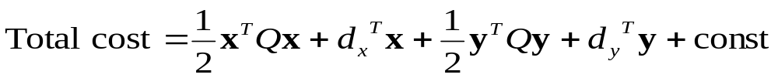
Quadratic Placement Formulation
Quadratic Placement Framework:
repeat
Solve the convex quadratic program
Spread the cells
until the cells are evenly distributed

Slide 30
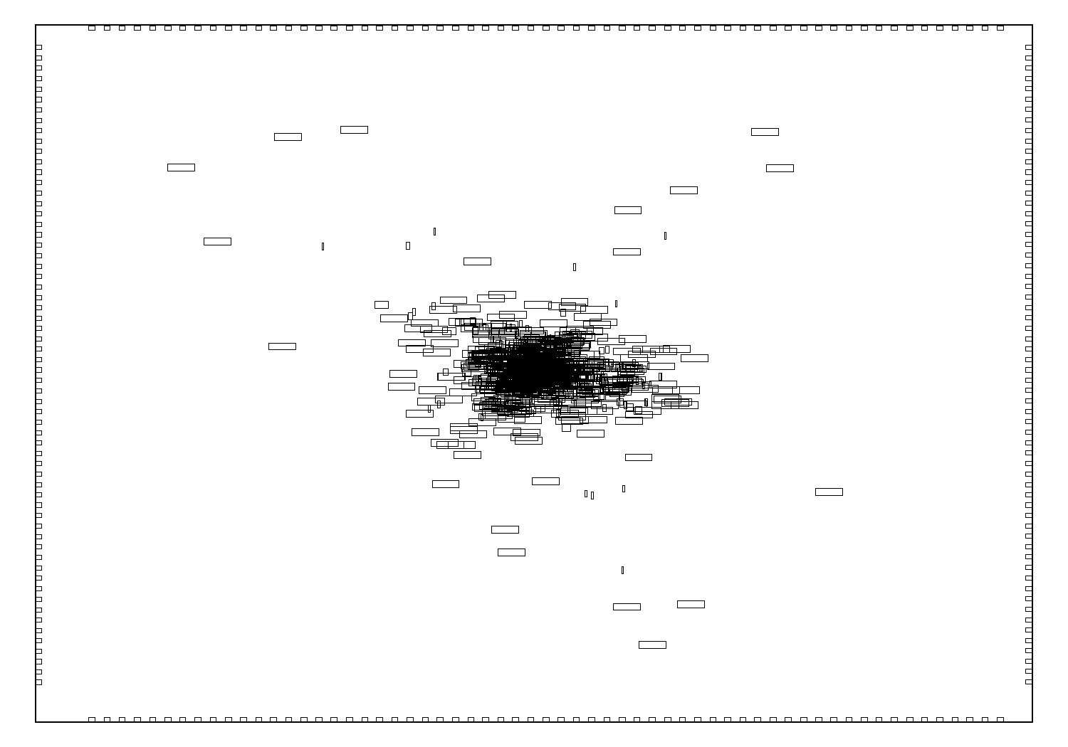
Solution of the Original QP

Slide 31
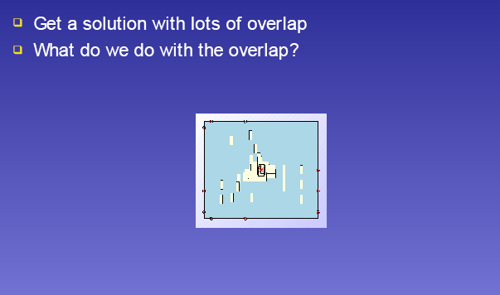
Quadratic Placement

Slide 32
Applying the Idea Recursively
Before every level of partitioning, do the Global Optimization again with additional constraints that the center of gravities should be in the center of regions.
Always solve a single QP (i.e., global).
Center of Gravities

Slide 33
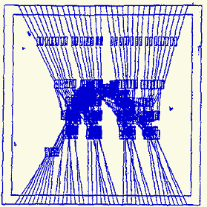
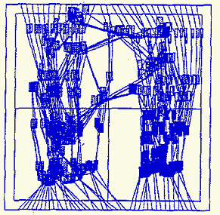
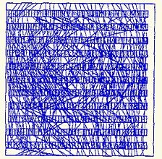
Process of Gordian
(a) Global placement with 1 region
(b) Global placement with 4 regions
(c) Final placements

Slide 34
Other Details
Sometimes, there are too much overlapping between modules (indicating a bad partitioning). In that case, merging 2 sub-partitions and repartition them is required.
When the size of sub-circuits are small enough, can stop partitioning. Then do a final placement of the sub-circuits according to the design style.

Slide 35
Quadratic Techniques: Pros
mathematically well behaved
very fast Analytical solution
Can handle large design size
- efficient solution techniques to find global optimum
- Can be used as an initial seed placement engine

Slide 36
Quadratic Techniques: Cons
can generate overlapped solutions: Post-processing required
not suitable for timing-driven placement
not suitable for simultaneous optimization of other aspects of
Physical Design (clocks, crosstalk, etc.)
yields trivial solutions with pads
fixed IOs are required for these techniques to work well

Slide 37
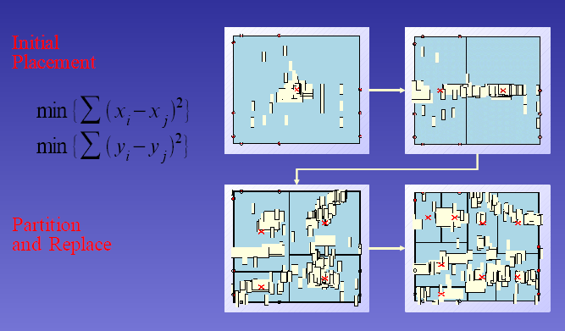
GORDIAN: Quadratic + Partitioning

Slide 38
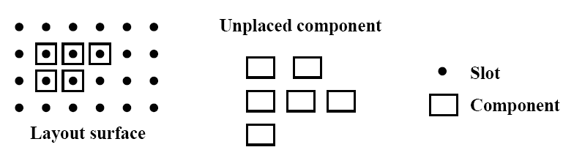
A down-to-the-earth method
Clustering growth
  Select unplaced components and place them in slots
  SELECT: choose the unplaced component that is most strongly connected to all (or any single) of the placed component
  PLACE: place the selected component at a slot such that a certain “cost” of the partial placement is minimized
  Simple and fast: ideal for initial placement

Slide 39
Cluster Growth For VLSI Placement
Bottom-up approach
Blocks placed in sequence in a partially completed layout
Position of Seed block usually chosen by user
Other blocks are next selected and placed in sequence
thumb rule - the block that has maximum inter-connection
with existing set is chosen
Individual Block placement based on positions of existing
blocks
OR
Some Best-first scheme may be adopted

